Slide 1
Movie recommendation system

Slide 2
abstract
A movie recommendation system is like a helpful friend who suggests movies you might enjoy. It looks at your past movie choices and suggest new ones that are similar to what you liked.
Recommender systems offer personalized recommendations, helping users discover shows and movies that align with their preferences. These systems can provide instant results or incorporate user feedback for further refinement. These user interactions can shape the recommendation algorithm and guide future suggestions for user-specific content.

Slide 3
Dataset usage
TMDb Movie Metadata Dataset:
The TMDb Movie Metadata Dataset is a comprehensive and widely used dataset in the field of movie data analysis and recommendation systems.
This dataset is hosted on Kaggle and provides valuable information about thousands of movies, including both popular and lesser-known titles.
It contains a variety of data fields, such as movie titles, release dates, genres, budgets, revenues, and user ratings, making it suitable for a wide range of data analysis tasks.
The dataset also includes cast and crew information, allowing for the exploration of
MovieLens 20M Dataset:
The MovieLens 20M Dataset is a rich and extensive dataset for movie ratings and recommendations.
It is provided by GroupLens Research and is one of the most widely used datasets for collaborative filtering and recommendation system development.
This dataset contains 20 million movie ratings from users, covering a diverse set of movies and genres.
Users provide ratings and reviews for movies, creating a valuable resource for user-based and item-based collaborative filtering approaches.

Slide 4
methodology
Content-Based Filtering
The content-based filtering aspect of the system utilizes natural language processing and information retrieval techniques to analyze the movie metadata.
Feature extraction is performed to identify key attributes for each movie, enabling similarity measurements.
Recommendations are generated based on user profiles, comparing user preferences with movie attributes like genre, director, and actors.

Slide 5
Popularity-Based Recommendations
The popularity-based recommendations rely on real-time user engagement data to identify trending and popular movies.
Movies are ranked based on various metrics, such as total views, user ratings, and recent user activity.
Users are presented with a list of movies that are currently popular or trending, allowing them to explore content that aligns with broader user interests.
Collaborative Filtering:
Collaborative filtering leverages user-user and item-item similarities in the dataset.
User-based collaborative filtering identifies users with similar preferences and recommends movies that were highly rated by these like-minded users.
Item-based collaborative filtering suggests movies that are similar to those a user has previously rated or interacted with, effectively offering personalized recommendations.

Slide 6
requirements
Hardware & Software Requirements
Software Requirements:
Amazon SageMaker/ Jupyter Notebook
Visual Studio
Libraries & Frameworks - Pandas, NumPy, Matplotlib, Scikit-Learn, NLTK
Windows 10
Web Browser
Hardware Requirements:
RAM - 30GB
SSD – 10GB

Slide 7
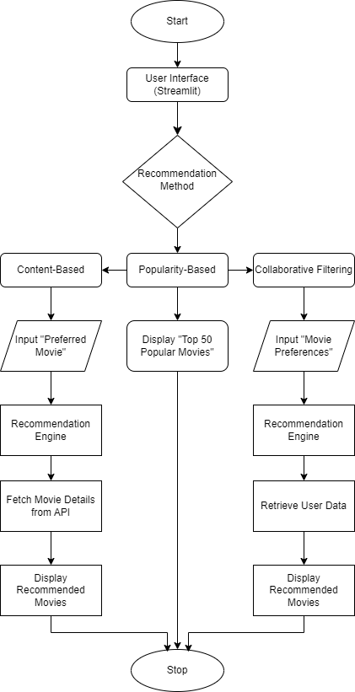
Flow Chart

Slide 8
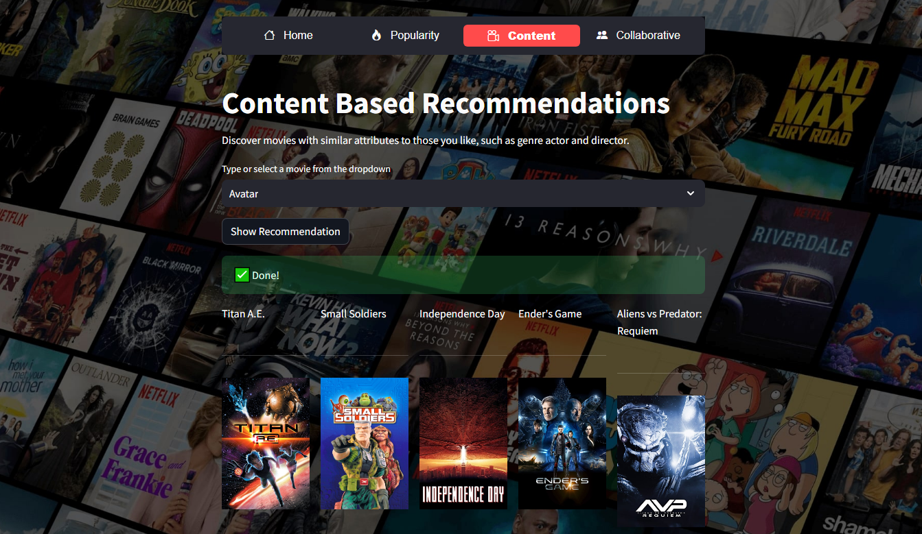
Screenshot
Content Based

Slide 9
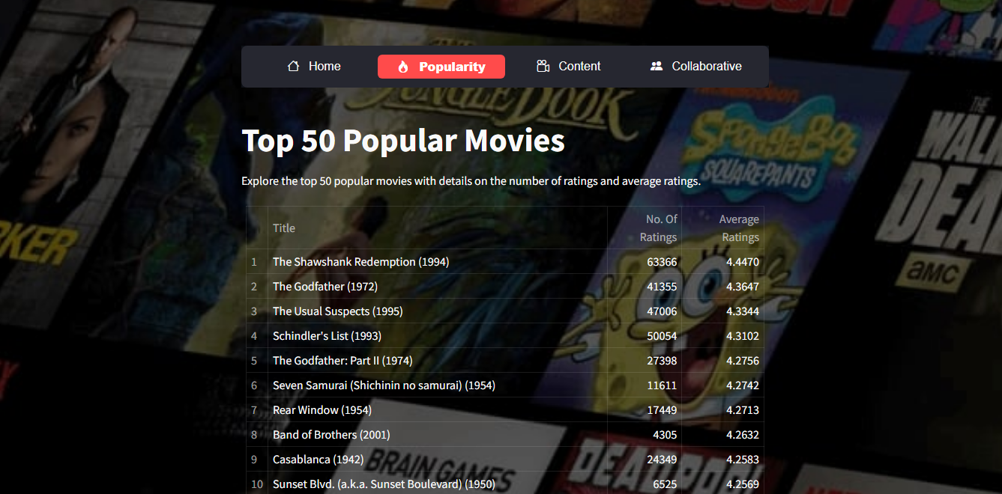
Popular Movies

Slide 10
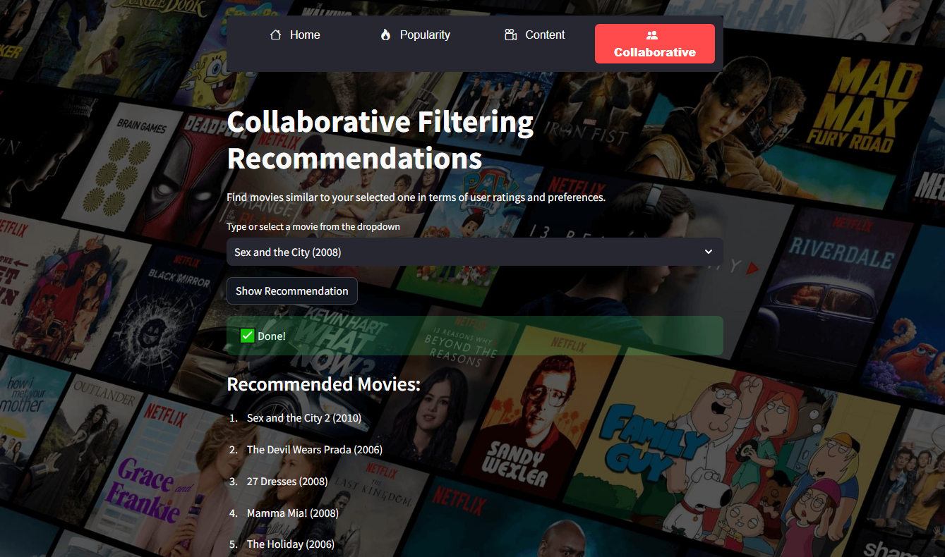
Collaborative Filtering Based

Slide 11
Future Enhancement
Use collaborative filtering recommendation.
After getting enough user data, collaborative filtering recommendation will be introduced.collaborative filtering is based on the social information of users, which will be analyzed in the future research.
Introduce more precise and proper features of movie.
Typical collaborative filtering recommendation use the rating instead of object features. In the future we should extract features such as color and subtitle from movie which can provide a more accurate description for movie.
Introduce user dislike movie list.
The user data is always useful in recommender systems. In the future we will collect more user data and add user dislike movie list. We will input dislike movie list into the recommender system as well and generate scores that will be added to previous result. By this way we can improve the result of recommender system.

Slide 12
Conclusion
The movie recommendation system represents a powerful and versatile application of machine learning and data analysis in the entertainment industry. This system leverages user preferences and movie attributes to offer personalized movie suggestions, enhancing the overall viewing experience for users. Through the analysis of user behavior and content features, the recommendation system can efficiently match viewers with movies that align with their tastes and preferences.
The movie recommendation system employs a variety of recommendation algorithms, including collaborative filtering, content-based filtering, and hybrid models, to provide accurate and diverse movie recommendations. This approach accounts for both the user's historical interactions with movies and the inherent characteristics of the films themselves.

